Slide 1
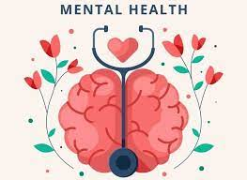


An Introduction to Supporting your Child’s Mental Health and Wellbeing
Parent Session
Holmfirth High School

Slide 2







Session Agreement
Notes:
From Left to Right – top row then 2nd Row
Signing in – Please ensure you have signed in
Supportive Learning Environment - Everyone has their own personal circumstances.
Listen – Please Listen to one another – No private conversations if possible
Mobile phone on silent if possible please – If you need to take a call please leave the room.
Time – Finishing time and whether there will be a break – Go to Toilet when needed don’t wait for break.
Confidential – unless a safeguarding concerns comes up
MHST – Quick overview of MHST
Participation – as much or as little as you are comfortable with.

Slide 3
Aims
Our aim is to provide information sessions for parents/carers to raise awareness of wellbeing needs in children and young people.
To provide helpful strategies and tips for parents/carers to support themselves and their children and Young People.

Slide 4


Slide 5
What is Mental Health?
How would you define and describe ‘mental health’?
Mental health includes our emotional, psychological, and social well-being. It affects how we think, feel, and act. It also helps determine how we handle stress, relate to others, and make choices.
Mental health is important at every stage of life, from childhood and adolescence through to adulthood.
Notes:
Discuss with person / people next to you. Feedback.

Slide 6
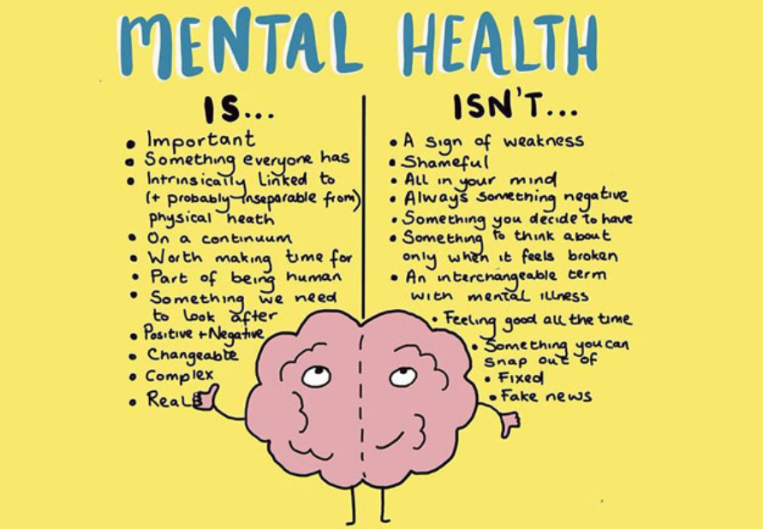

Slide 7
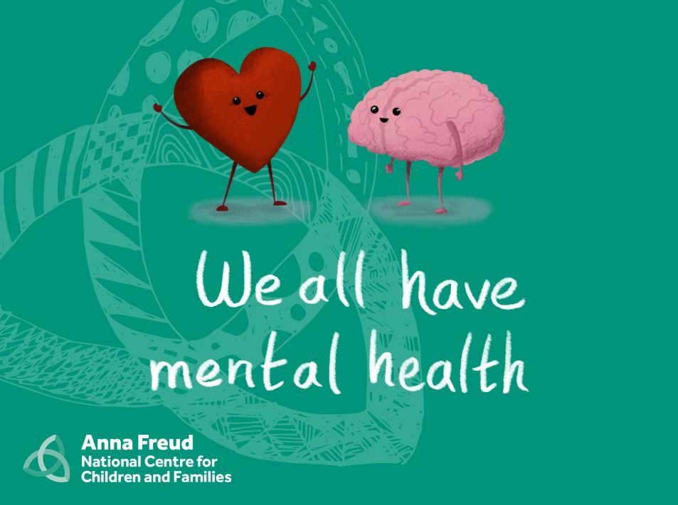
Notes:
Watch Video
https://www.youtube.com/watch?v=DxIDKZHW3-E

Slide 8

Notes:
Watch Video
https://www.youtube.com/watch?v=DxIDKZHW3-E

Slide 9
Why Talk About Mental Health and Wellbeing in Children?
One in six school-aged children has a diagnosable mental health problem.
This is an alarming rise from one in ten in 2004 and one in nine in 2017.
Post-pandemic, this figure has not reduced.
(NHS Digital 2021)

Slide 10
Physical Health v Mental Health
When we think of the word ‘healthy’ we can categorise this in terms of physical health, mental heath, social wellbeing and absence of a long-term disease or illness.
To improve our physical health and immune system, there are many things we can do e.g. consider our diet, fitness, medication and self care.
It is equally important to consider mental health, especially for children, in the same way.

Slide 11
Good mental health in a child’s early years is….
Predictive of good mental and physical health in adulthood

Slide 12
The Spectrum of Mental Health
High Emotional Health | General Wellbeing | Intervention Required
Resilient, self-assured and confident Able to cope with the demands of life. Demonstrate positivity towards themselves Have healthy relationships Can manage a variety of feelings, from sadness to anger Bounce back from tougher times and challenging situations. Strong sense of belonging Feel loved, trusted, safe, valued and supported. Able to learn and succeed. | Generally manage their home and school life positively, with no external professional help required. May have episodes of difficulties from time to time, but they can usually cope with these via support from adults around them. | May be struggling with their behaviour, emotions or self esteem, as a result of several different factors or experiences. Feeling of poor mental health is likely to be present over a long period of time, with the child finding it difficult to bounce back from difficulties. It is likely they may need some external support from a trained professional.
Little People’s Mental Health (2019): Tammy Fioravanti-Clarkson
Notes:
Understand ourselves, values, That’s we like ourselves
How we fit in, to family – What do you think? Valuing Options
If children feel out of control – need to feel included
Need full attention – Being positive
Be specific about what they are good at.
Solve problem
Normalize we all worry

Slide 13
Poor Mental Health:
Interferes with children’s ability to learn, enjoy friendships and relationships and deal with the difficulties they face.
They may show attachment difficulties and school anxiety / refusal.
They may be anxious or frightened, lose interest and withdraw or have difficulties concentrating.
It may impact on sleep and eating habits.
They may be aggressive or disruptive and get into trouble with authority.
They may develop inappropriate coping strategies e.g. self-harm.

Slide 14
The Good News…
Parents and carers can play an important role in improving, developing and maintaining positive mental health at home.
Children who have developed positive coping skills and resilience during their school years via their home life and parental influence are less likely to require intervention from professionals later.

Slide 15
Key Ways Parents Can Support
Helping children to express feelings and emotions.
Encouraging open communication.
Ensuring children have appropriate levels of unstructured free-play and suitable periods of time to relax.
Developing positive sleep patterns.
Creating healthy boundaries.
Managing technological usage.
Supporting with mistakes, failures and coping when things go wrong (building resilience).
Helping children to develop self-care skills.

Slide 16
To increase positive mental health we need to…..
Reduce risk and increase resilience

Slide 17
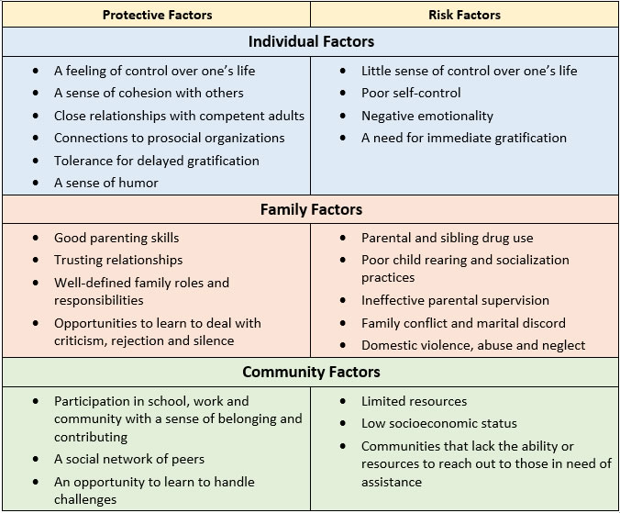
Risk & Protective factors for CYP’s Mental Health
Notes:
The presence of multiple risk factors can make a young person more susceptible to experiencing a mental health problem

Slide 18
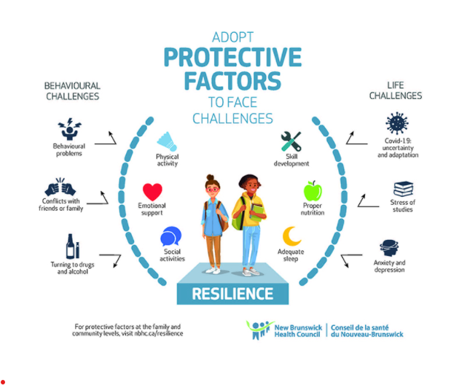

Slide 19

What is Resilience
Resilience is the ability to adapt to difficult situations. When stress, adversity or trauma strikes, you still experience anger, grief and pain, but you're able to keep functioning — both physically and psychologically.

Slide 20
To Build resilience, children need?
Good parent/child relationships
Positive peer relationships
Individuality/strong identity
Good communication skills
Positive self-esteem/self-worth
Problem solving abilities
Self-reflection
Empathy

Slide 21
Anxiety: A Summary
Anxiety is a normal feeling
Occurs in times of stress or challenge
Body produces stress hormones, such as adrenaline and cortisol
Fight, flight or freeze reaction
Can be useful in preparing for new or challenging situations
Irrational fears
Redistribution of blood: away from head and stomach to muscle groups
Can cause physical symptoms or lead to panic attacks

Slide 22
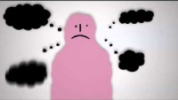
Anxiety

Slide 23
Worry v Anxiety
We tend to feel worry in our heads, and anxiety in our bodies
Worry tends to be specific, anxiety more general
Worry can be more verbally focused while anxiety includes verbal thoughts and mental/physical affects
Worry can trigger problem solving behaviour, anxiety does not (unless aware)
Worry creates mild distress, anxiety more severe
Worry is caused by realistic concerns whilst anxiety often irrational
Worry tends to be controllable, anxiety much less so
Worry can be a temporary state, anxiety often lingers
Worry doesn’t impact our day-to-day functioning, anxiety does
Worry is considered a “normative” psychological state, whilst unnecessary anxiety is not

Slide 24
How to Spot Signs of Stress and Anxiety in your Child

Slide 25
Spotting the Signs of Stress
Children and young people who are stressed may:
Worry a lot
Feel tense
Have headaches and stomach pains
Not sleep well
Be irritable
Lose interest in food or eat more than normal
Not enjoy activities they previously enjoyed
Be negative and have a low mood
Feel hopeless about the future
Having someone to talk to about their work can help. Support from a parent, tutor or study buddy can help young people share their worries and keep things in perspective.
Encourage your child to talk to a member of school staff who they feel is supportive. If you think your child is not coping, it may also be helpful for you to talk to their teachers.
Try to involve your child as much as possible.
Notes:
Discuss with person / people next to you. Feedback.

Slide 26
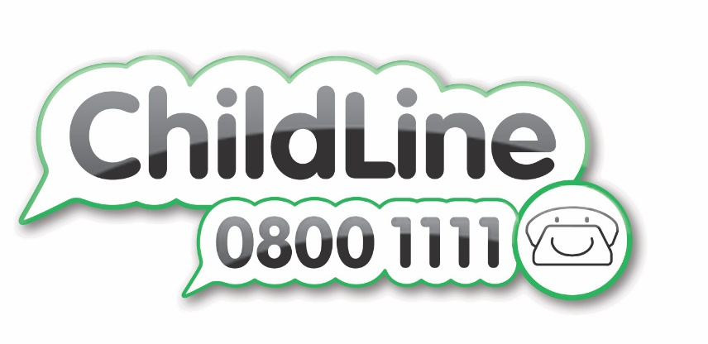
The ChildLine National Exam Stress Survey revealed that:
96% of students feel anxious about exams (no matter what your friends say they ARE stressed too),
59% of students feel pressure from family.
64% of students would like more support with exams and exam stress.

Slide 27
Top Tips for Parents in Supporting your Child during Stressful Periods
Notes:
Discuss with person / people next to you. Feedback.

Slide 28
Talk about Stress & Worry
Remind your child that it's normal to feel anxious. Nervousness is a natural reaction, especially during assessments, coursework deadlines and exams. The key is to put these nerves to positive use.
If anxiety is getting in the way rather than helping, encourage your child to practise the activities they'll be doing on the day of the exam. This will help it feel less scary.
For example, this may involve doing practice papers under exam conditions or seeing the exam hall beforehand. School staff should be able to help with this.
Help your child face their fears and see these activities through, rather than avoiding them.
Encourage them to think about what they know and the time they've already put into studying to help them feel more confident.
Notes:
Discuss with person / people next to you. Feedback.

Slide 29
Ensuring a Healthy Diet
A balanced diet is vital for your child's health, and can help them feel well during exam periods.
Some parents find high-fat, high-sugar and high-caffeine foods and drinks, such as energy drinks, cola, sweets, chocolate, burgers and chips, make their children hyperactive, irritable and moody.
Where possible, involve your child in shopping for food and encourage them to choose some healthy snacks.
Notes:
Discuss with person / people next to you. Feedback.

Slide 30
Supporting Good Sleep
Good sleep improves thinking and concentration.
Most teenagers need 8 to 10 hours' sleep a night.
Allow half an hour or so for your child to wind down between studying, watching TV or using a computer and going to bed, to help them get a good night's sleep.
Cramming all night before an exam is usually a bad idea. Sleep will benefit your child far more than a few hours of panicky last-minute study.
Notes:
Discuss with person / people next to you. Feedback.

Slide 31
Encourage Exercise
Exercise can help boost energy levels, clear the mind and relieve stress. It does not matter what it is – walking, cycling, swimming, football and dancing are all effective.
Activities that involve other people can be particularly helpful.
Notes:
Discuss with person / people next to you. Feedback.

Slide 32
Be Flexible
Be flexible around exam time. When your child is revising all day, do not worry about household jobs left undone or untidy bedrooms.
Staying calm yourself can help. Remember, exams do not last forever.
Notes:
Discuss with person / people next to you. Feedback.

Slide 33
Don’t Add Pressure
Support group Childline says many children who contact them feel that most pressure at exam time comes from their family.
Listen to your child, give them support and avoid criticism.
Before they go in for a test or exam, be reassuring and positive. Let them know that failing is not the end of the world. If things do not go well they may be able to take the exam again.
After each exam, encourage your child to talk it through with you. Discuss the parts that went well rather than focusing on the questions they found difficult. Then move on and focus on the next test, rather than dwelling on things that cannot be changed.
Notes:
Discuss with person / people next to you. Feedback.

Slide 34
Make Time for Treats
With your child, think about rewards for doing revision and getting through each exam.
Rewards do not need to be big or expensive. They can include simple things like making their favourite meal or watching TV.
When the exams are over, help your child celebrate by organising an end-of-exams treat.
Notes:
Discuss with person / people next to you. Feedback.

Slide 35

Don’t forget - If you are still trying you
ARE coping…
Remember that you are not alone
Gentle exercise
Picture your success
Exams are not the be all and end all
Get enough sleep
Diet
A productive environment
You ARE Stronger then you feel!

Slide 36

Most importantly – your wellbeing!
When you’re caring for the emotional wellbeing of others, it easy to forget your own. But to fully support the young people in your care, you need to make sure your are cared for too
Therefore, addressing the wellbeing of carers is a vital step to addressing the wellbeing of young people because engaged, cared for carers are better able to care for young people.
Get help for yourself if needed to support more effectively.

Slide 37

https://holmfirthhigh.co.uk/pastoral/well-being/

Slide 38







Accessing Support through Thriving Kirklees
www.thrivingkirklees.org.uk
Notes:
Chews
Provides short term targeted intervention through counselling, direct support, group work and telephone support calls
Children need to be aged 5-17
Have a GP in Kirklees
Have emotional and mental health issues which are impacting their daily functioning
Are ready and willing to engage in support
Not already engaged in other support through schools, school nurses or other services

Slide 39
Northorpe Hall
  We provide mental health support for people aged 0-18 in the Kirklees area. We offer counselling, 1-1 support with mental health practitioners, activity groups and one-off workshops, as well as advice, information and support over the phone or regular support calls.

Slide 40

Chathealth
Available Monday to Friday from 8am to 8pm
Young people aged 11-19: 07520 618866
Parents/carers: 07520 61886

Slide 41

Kooth.com is a free, online counselling and emotional wellbeing platform for young people in Kirklees aged 11 to 19
The Kooth website allows young people to gain anonymous access to advice, support and guidance on any issue that is affecting their wellbeing.
Our qualified counsellors are here to give young people the support they need, when they need it. Kooth.com’s live chat service is available from Monday to Friday 12 noon - 10pm, Saturdays and Sundays 6pm - 10pm and is accessible through mobile, tablet and desktop.

Slide 42


Slide 43




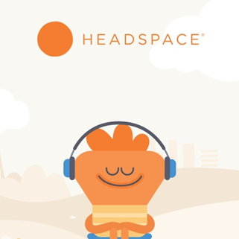

Apps
Notes:
Explain apps
Kooth is anonymous and free at the point of use. Online counselling is available to users through instant chat messaging from mid-day until 10pm on weekdays and from 6pm until 10pm at weekends.
MindShift app - helps young adults cope with anxiety, by acting as a portable coach that guides users through challenging situations. This app teaches users how to relax and helps them identify active steps to directly face and take charge of their anxiety.
Headspace - Guided Meditations and Mindfulness takes a calm, relaxed approach to bringing calm relaxation into the lives of adults and kids. Headspace app, aims to keep children “calm and focused” through short meditation exercises.
Calm - is the perfect meditation app for beginners, but also includes hundreds of programs for intermediate and advanced users. Guided meditation sessions are available in lengths of 3, 5, 10, 15, 20 or 25 minutes so you can choose the perfect length to fit with your schedule.
My Life – Check in with how your feeling and try short guided meditations and mindfulness activities, tuned to your emotions.
Catch It App – Teaches you how to look at problems in a different way turns negative thoughts into positive ones and improve your mental wellbeing.
The worry tree –
Chill Panda
Meetwo

Slide 44


